Slide 1
HUMAN RESOURCE MANAGEMENT PROJECT
K14T – Team 05

Slide 2
Agenda
Introduction
Process
Planning & Actual
Phases
Lesson learns

Slide 3
INTRODUCTION

Slide 4
Team mentors
The team
Lead Requirement
Quyet Nguyen
Lead Architect
Tuong Nguyen
Lead Detail Design
Dang Nguyen
Lead Test
Tung Nguyen
Nguyen Dinh
Loc Phan
Project Manager
Nhung Huynh
Technical Lead Tan Tran
Nguyen The Quang
Dinh Duc Tri

Slide 5
PROCESS

Slide 6
SYSTEM CONCEPT
DETAIL DESIGN
PROGRAMMING
TESTING
RELEASE PRODUCT
REQUIREMENT & ARCHITECT
Tailor with ACDM
INCREMENTAL

Slide 7
PLANNING & ACTUAL

Slide 8
Duration estimation
Total effort a week: 34 hours/person
Total effort a week for Caps: 272 hours
Required effort: 6510.8
Required week: 24 weeks + 4 weeks for Tet holiday = 28 weeks
Plan 1: late 4 weeks
Plan 2: late 4 days
Total: late 4.4 weeks

Slide 9
Milestone
Task Name | Start | Finish
Start Up | 9/28/11 | 10/1/11
Requirement Analysis | 10/4/11 | 1/24/12
Architect Design Analysis | 11/4/11 | 2/11/12
Design Database | 2/11/12 | 2/29/12
Testing | 1/24/12 | 2/15/12
Increment 1: Detail Information Management | 3/10/12 | 3/31/12
Increment 2: Training Management | 3/24/12 | 4/14/12
Increment 3: Report | 4/14/12 | 5/1/12
Deliver to customer | 5/15/12 | 5/22/12

Slide 10
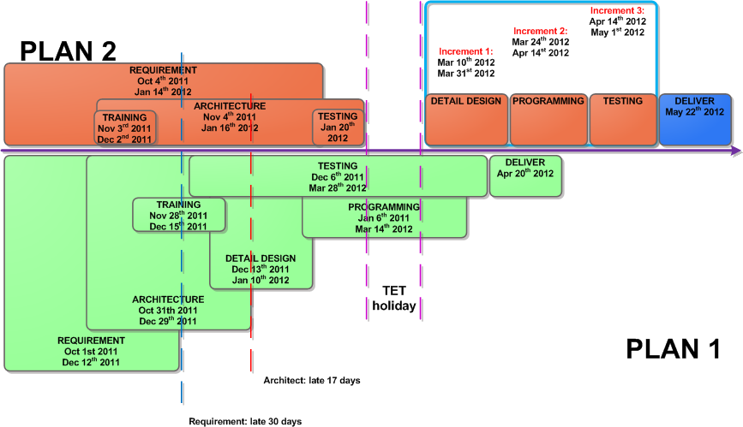
Project phases
Notes:
Project planning should describe how the team will:
Work breakdown structures
Task estimation
Chart – for comparing actual with plan
Process should describe:
Project process: reason why team can select it
Process for each stage.
Số người, thời gian trong từng giao đoạn

Slide 11
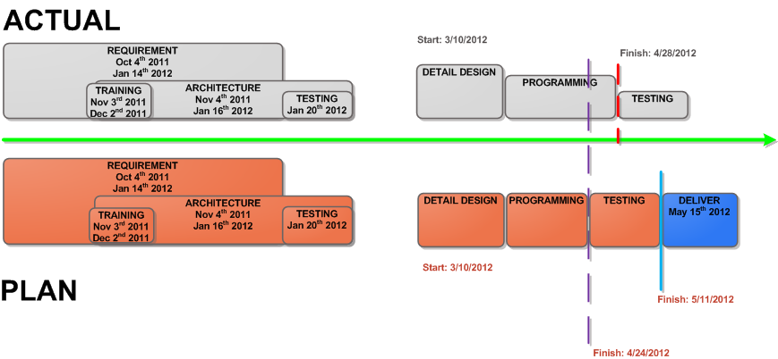
Project phases

Slide 12
Deliverables checklist
Requirement:
Concepts of Operation
Software Requirement Specification
Design:
HRM Architecture Driver
HRM Architecture Design
Notes:
All the documents throughout development phases:
Project performance measurement
3. Requirements
Team should address two documents:
concept operation: a communication channel among team members, stakeholders to stakeholders and
SRS:
4. Designs
Team should address:
SAD
Architecture design

Slide 13
Deliverables checklist
Test cases
Unit test
Integration testing
System testing
Acceptance testing
Notes:
Hardware (PC / Laptop)
Hard disk free space: About 2 GB
Memory: more than 512 MB free memory with default cache settings
CPU: Equal or more than Pentium 4-2.0 GHz
Software:
Windows XP SP2, Windows Vista, Windows 7
C #, MS SQL Server 2005, Microsoft Visual Studio 2010
Using Internet Explorer browser to test system testing

Slide 14
REQUIREMENT

Slide 15
Lesson learned
Change Management is not good
Lack of researching Business Process Information
Lack of analysis Business Process Information
Not give solutions for Customers

Slide 16
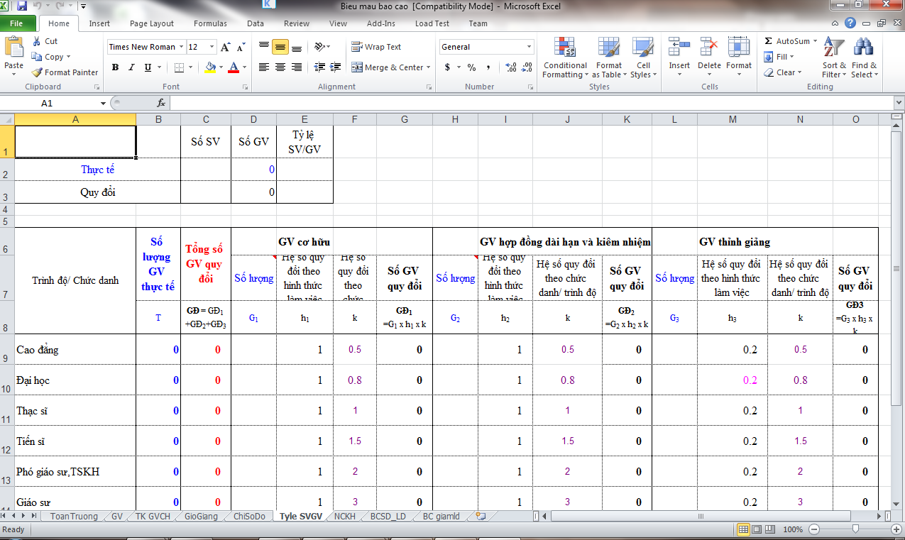
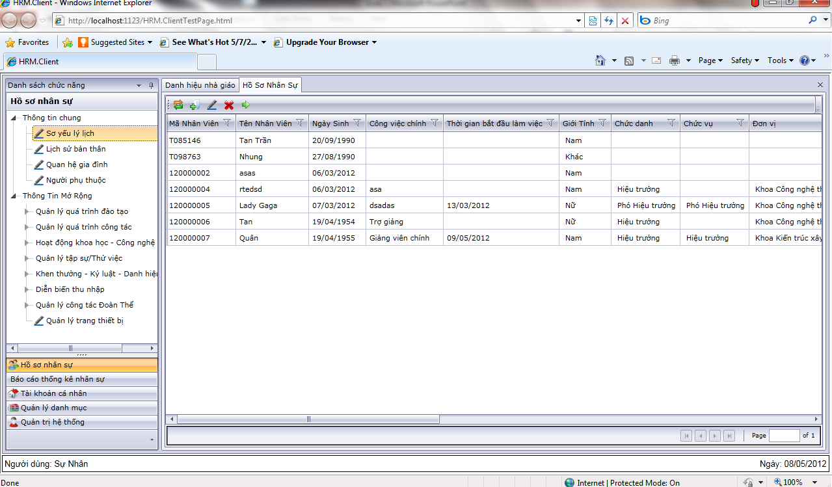
Product overview
Resolving problem when using Microsoft Excel to manage human resource by replacing System Personal Information Management

Slide 17
Product overview
Client: Human Resource Planning and Managing Department of VLU
Responsibility:
Recruitment Management
Personal information management
Insurance Information Management
Employee labor contract management
Assessment Management
Payroll
The needs of using a software
Notes:
Product overview will describe statement of work: The purpose of statement of work is to describe the relationship between client and team.
General project description and outline. Client
Description of client and domain
Description team
General responsibilities of team and client

Slide 18
General data flow
1.
Recruitment Management
2.
Personal Information Management
3.
Employee Labour Contract
Management
4.
Insurance Information Management
5.
Employee Labour Management
6.
Assessment Management
7.
Payroll Management

Slide 19
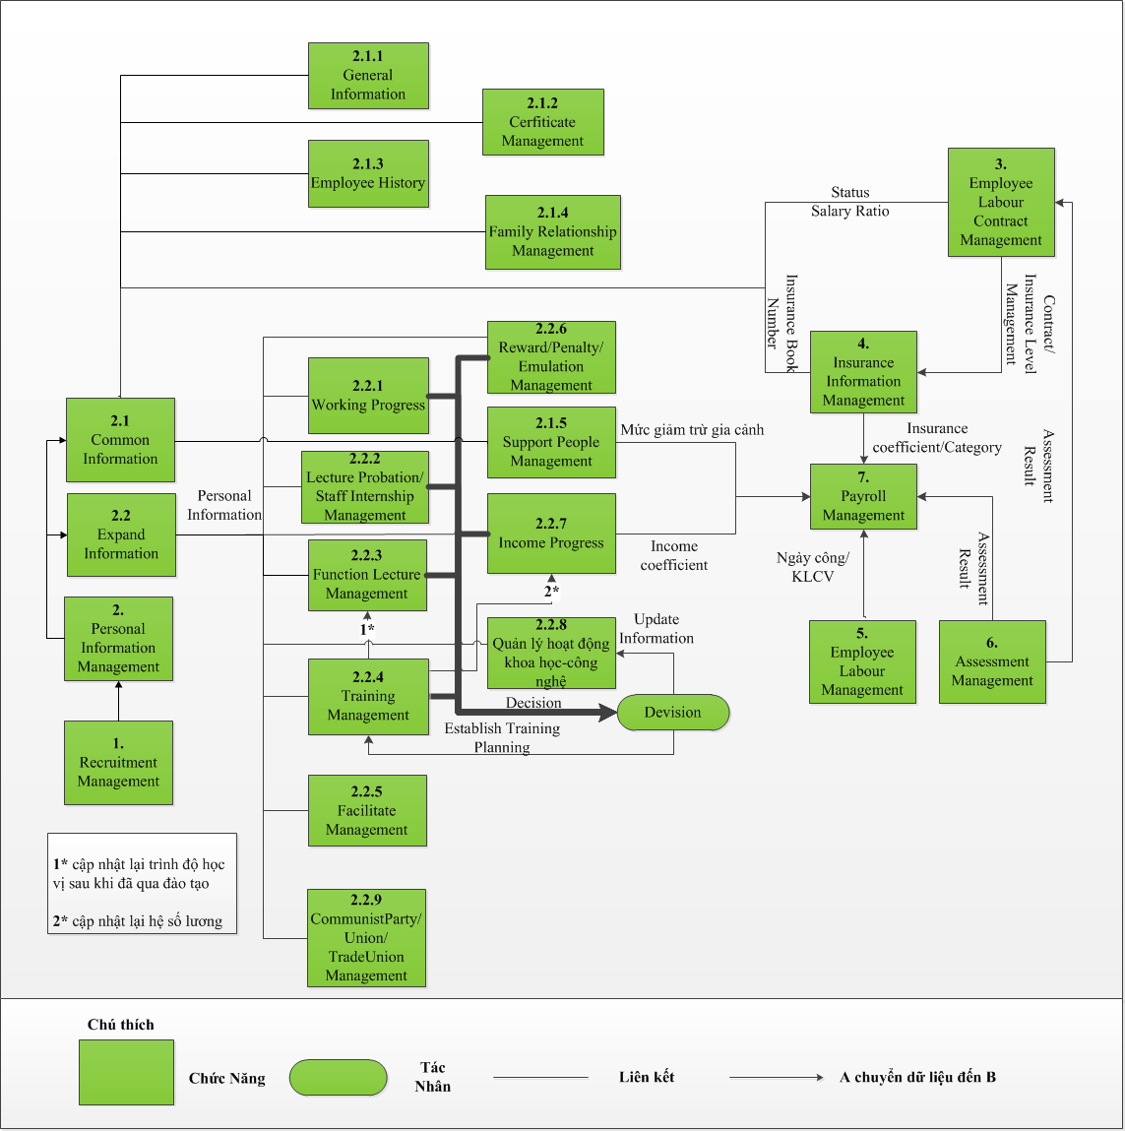
Function Disintegration Model

Slide 20
Context diagram

Slide 21
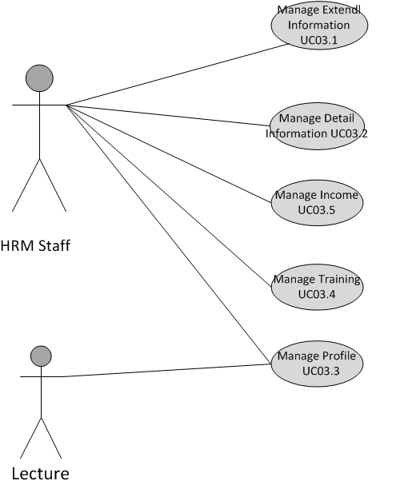
System use case

Slide 22
Quality attributes
Performance
Security
Usability
Scalability
Modifiability
Availability

Slide 23
ARCHITECTURE

Slide 24
Architecture driver document

Slide 25
High level requirement
FR01. Detail Information Management
FR02. Training Management
FR03. Extended Information Management
FR04. Profile Management
FR05. Income Management
FR06. Catalog Management
FR07. User Management

Slide 26
Quality attributes
No. ID | Quality Attribute Name | Priority
QA. 01 | Performance | 2
QA. 02 | Security | 1
QA. 03 | Usability | 3
QA. 04 | Scalability | 2
QA. 05 | Modifiability | 1

Slide 27
Quality attribute scenario - Security
Title of scenario: Ability to protect the database from attacker | ID: QA.02 | Version: 1.1
 |  | Last Changed: 11/29/2011
Quality attribute: Security | Characterization ID: QAS.04
Describe stakeholder role proposing the description: Architect
Source(s) of the stimulus | The unauthorized user
Stimulus | Access and attack database server
Relevant environmental conditions | The HRM system is in normal mode
Architectural elements | The HRM database, HRM server
System response | The user will not know the path of database server and database is protected.

Slide 28
QA scenario – Modifiability (1)
Title of scenario: Ability to add new functionalities/modules such as recruitment, insurance… modules |  | ID: QA.05 | Version: 1.0
 |  |  | Last Changed: 11/7/2011
Quality attribute: Modifiability |  | Characterization ID: QAS.08
Describe stakeholder role proposing the description: Architect
Source(s) of the stimulus | The developer, end-users
Stimulus | Add new functionalities/modules including recruitment, insurance, labor contract, payroll, assessment management, reward and penalty management, labor management modules
Relevant environmental conditions | The HRM system is in build time
Architectural elements | The HRM system client and server side
System response | -Locates places in architecture to be modified. The UI component on client side The services and business flow on server side. -Makes modification without affecting other functionality -Tests modification -Deploys modification
Response measure(s) | The time for adding: 2-3 days The resource for adding: 2 resources (one for integration and the other for testing and deploy)

Slide 29
QA Scenario – Modifiability (2)
Title of scenario: Ability to modify the authority of the user | ID: QA.05 | Version: 1.0
 |  | Last Changed: 11/7/2011
Quality attribute: Modifiability | Characterization ID: QAS.09
Describe stakeholder role proposing the description: Architect
Source(s) of the stimulus | Administrator
Stimulus | Modifying the authority of the user
Relevant environmental conditions | The HRM system is in run time mode
Architectural elements | The HRM system server side
System response | -The system will load configure again -The authority of the user will be changed

Slide 30
QA Scenario – Modifiability (3)
Title of scenario: Ability to modify the client from using Silverlight to Windows Form (WPF) |  | ID: QA.05 | Version: 1.0
 |  |  | Last Changed: 11/7/2011
Quality attribute: Modifiability |  | Characterization ID: QAS.010
Describe stakeholder role proposing the description: Architect
Source(s) of the stimulus | The developer, end-users
Stimulus | Wish to modify the client side from using Silverlight (web browser application) to windows form application (WPF)
Relevant environmental conditions | The HRM system is in build time
Architectural elements | The HRM system client
System response | -Locates part for modification The View and Model component -Makes modification without affecting the functionality in other tiers -Tests UI
Response measure(s) | The time for modifying: 5-7 days The resource for adding: 2 resources (one for modifying and the other for testing and deploy)

Slide 31
Technical constraint
ID | Constraint name | Constraint Description
TC.PIM.1 | Development framework | .Net 4.0, WCF, Silverlight, Entity framework
TC.PIM.2 | Network | Network is ADSL/Mega WAN
TC.PIM.3 | Programming language | Using C#
TC.PIM.4 | Third-party | - Using Microsoft Word, Excel for documenting, importing, and exporting the data. - Use the Authentication component from Van Lang IT Department

Slide 32
Architecture design document

Slide 33
C&C view- HRM system

Slide 37
C&C view- HRM system

Slide 40
Modules view- HRM system

Slide 43
Modules view- HRM system

Slide 45
DETAIL DESIGN

Slide 46
Approach
Requirement
Architect
Functions & Business Rule
Key Function & Quality
Detail Design

Slide 47
Process identify
DEFINITION
ANALYSIS
EVALUATION
DETAIL DESIGN
VERIFICATION
Re-Identify
Re-Design

Slide 48
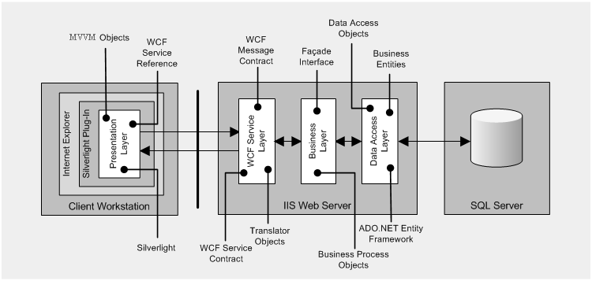
Implement pattern

Slide 49
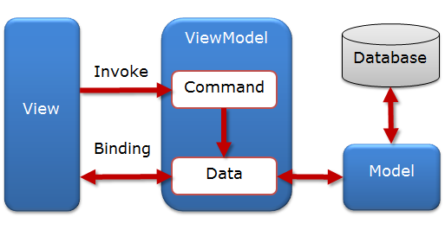
Implement pattern
Binding &
Action
Properties
Commands
Methods
Properties
DomainObject
Client Layer
Business Layer
MVVM

Slide 50
Detail design
Form:
File List
Function List
Design:
Client Class Diagram
Business Class Diagram
Entity Diagram
Sequence Diagram

Slide 51
TESTING

Slide 52
Test process
Test Planning
Test Development
Test Execution
Defect Reporting
Retest Defects
Product Delivery
Notes:
Project planning should describe how the team will:
Work breakdown structures
Task estimation
Chart – for comparing actual with plan
Process should describe:
Project process: reason why team can select it
Process for each stage.

Slide 53
Testing
Required Resource:
Human Resource
Environment: Hardware, Software
Test Phases:
Unit testing
Integration testing
System testing
Acceptance testing
Notes:
Hardware (PC / Laptop)
Hard disk free space: About 2 GB
Memory: more than 512 MB free memory with default cache settings
CPU: Equal or more than Pentium 4-2.0 GHz
Software:
Windows XP SP2, Windows Vista, Windows 7
C #, MS SQL Server 2005, Microsoft Visual Studio 2010
Using Internet Explorer browser to test system testing

Slide 54
Test case rate of function

Slide 55
Program status report

Slide 56
LESSON LEARNS

Slide 57
Lesson learned
Change methodology, team can not follow V model, we must modify it
Not familiar with Microsoft Project
Estimate for every phase not good
Cannot manage good requirement phase
Measure working progress and make it better
How to deal with customers’ changes
How to get accustomed to using new technology
Understand what a real project is

Slide 58
THE END

Slide 59
Future improvements
Apply ACDM for Requirement and Architecture phases
Apply INCREMENTAL for 3 phases: Detail design, Programming, Testing

Slide 60
Team Reflection
Measure working progress and make it better
How to deal with customers’ changes
How to get accustomed to using new technology
Understand what a real project is
Notes:
I1: take more attention to effort log and improve each and every team member productivity so that we can work better. That is: update personal time log regularly, and actually use them
I2: Changes are very arrogant in our project. Customers still want to change after the product has been designed. In addition, we do not have out voice in negotiating with customers since they are working
I3: throughout all the projects in 4 years, we always work with new technology. Therefore, step by step, we know how to adapt new technologies as quickly as possible.
I4: the importance of changes, risk, requirement, what a real customer is
Lack of knowledge about HR business => problems to elicit requirements, Architect: Utilize Quality

Slide 61
BACKUP PROCESS

Slide 62
BACKUP PLANNING

Slide 63
Future improvements
Research for using Microsoft Project
Re-estimate

Slide 64
Human Resource Management
Project Management
Design template for managing
Plan for all pharse of project
Requirement Analysis
Elicitate requirement
Architect Design Analysis
Detail Design Analysis
Develop ADD
Programming
Design database
Testing
Design test cases
Deployment
Transition
Analysis requirement
Develop ConOfOper
Develop SRS
Descript Use-case
Develop Interface
Review
Develop AD
Analysis
Conduct test cases
Training
Programming
Dev SDS

Slide 65
Human Resource Management
Project Management
Research
Plan
Requirement Analysis
Concept Operation
Architect Design Analysis
Increment 1
Develop ADD
Increment 2
Design
Increment 3
Deliver
SRS
Develop AD
Code
Test

Slide 66
BACKUP REQUIREMENT

Slide 67
Requirement process
Notes:
Project planning should describe how the team will:
Work breakdown structures
Task estimation
Chart – for comparing actual with plan
Process should describe:
Project process: reason why team can select it
Process for each stage.

Slide 68
BACKUP RISK MANAGEMENT

Slide 69
Risk process
RISK MANAGEMENT PLANNING
RISK IDENTIFICATION
RISK RESPONSE PLANNIG
RISK MONITORING & CONTROL
QUALITATIVE RISK ANALYSIS
QUANTITATIVE RISK ANALYSIS

Slide 70
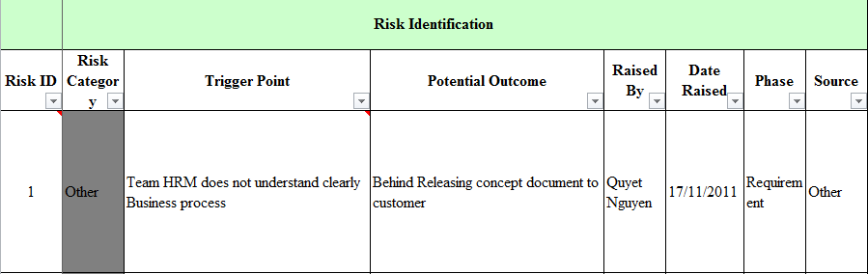
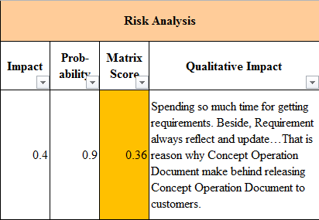
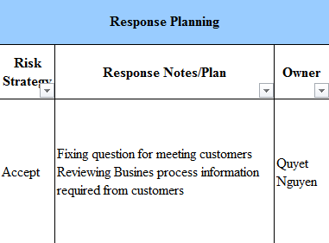
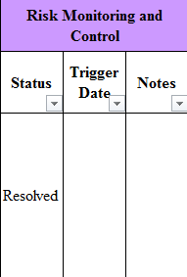
Risk register

Slide 71
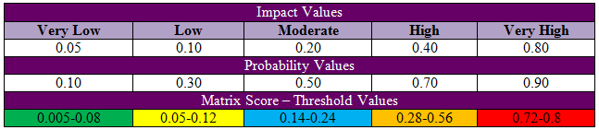
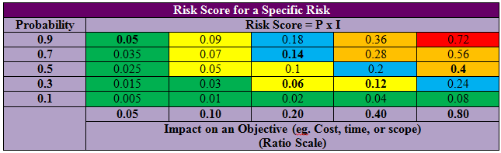
Risk register

Slide 72
Risk report
Red: 1
Orange: 11
28 risks
Yellow: 4
Green: 12
Status: Resolved 28 risks

Slide 73
BACKUP CONFIGURATION MANAGEMENT

Slide 74
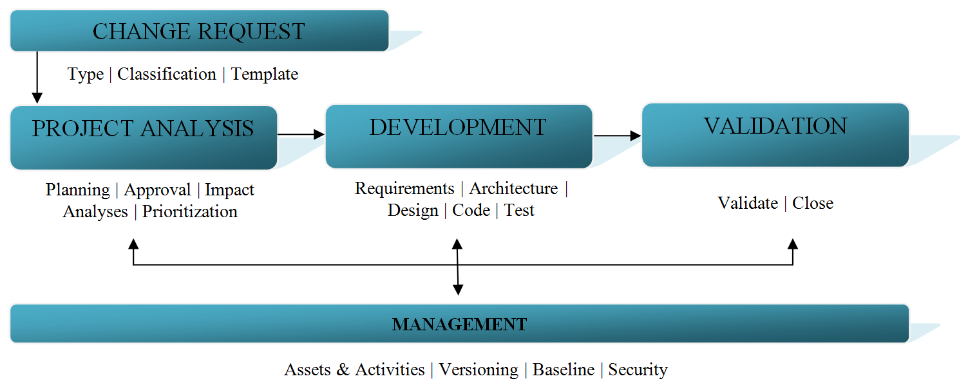
Configuration management
Notes:
Project planning should describe how the team will:
Work breakdown structures
Task estimation
Chart – for comparing actual with plan
Process should describe:
Project process: reason why team can select it
Process for each stage.

Slide 75
Status deliverables checklist
Notes:
All the documents throughout development phases:
Project performance measurement
3. Requirements
Team should address two documents: concept operation and SRS
4. Designs
Team should address:
Architecture design
Detail design (optional)
5. Test plan
Test plan should address:
Estimate for how much time will be devoted to test
Test schedules
Resource require (user, environment, equipment, so forth)
Unit, integration, deployment testing
Product or system test
Test coverage

Slide 76
BACKUP TESTING

Slide 77
Defect life cycle
Notes:
5. Test plan
Test plan should address:
Estimate for how much time will be devoted to test
Test schedules
Resource require (user, environment, equipment, so forth)
Unit, integration, deployment testing
Product or system test
Test coverage

